Slide 1
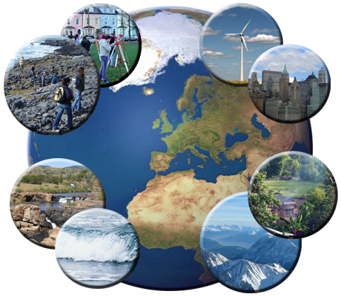
INTRODUCTION TO GEOGRAPHY
WHY WE STUDY GEOGRPAHY AND GEOGRPAHY CONCEPTS AND SKILLS
Opening clip https://www.youtube.com/watch?v=I3YfE9VLFoA

Slide 2
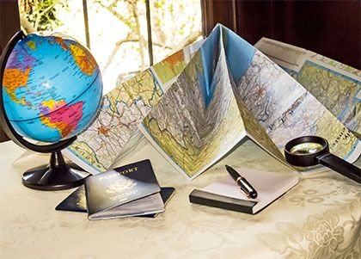

LG: We will understand what is geography, why we study it and what are the key skills and concepts.
CS: We will complete a brainstorm about geography skills and match up key concepts and definitions.

Slide 3
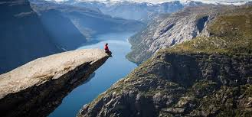
What is geography?
Geography is study of people and places in the world
Geography can be divided into two main areas, physical geography and human geography

Slide 4
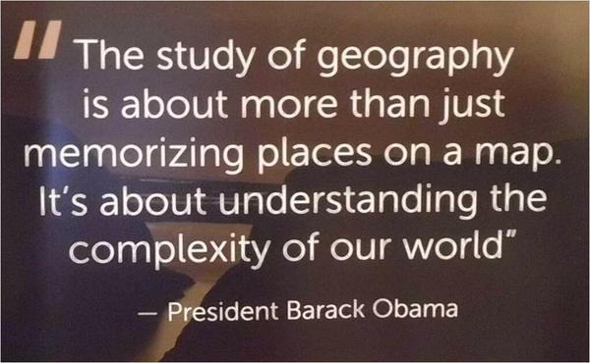
Why we study geography

Slide 5
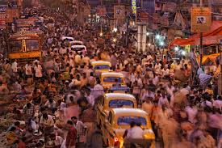
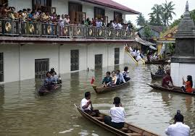
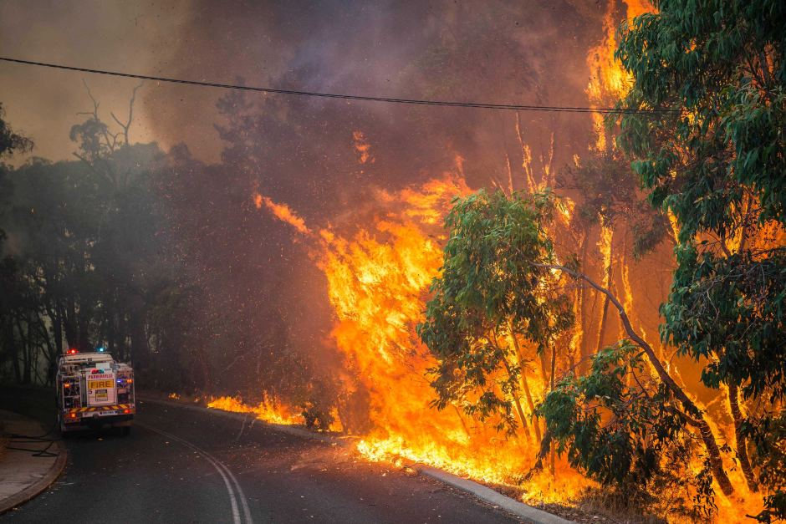
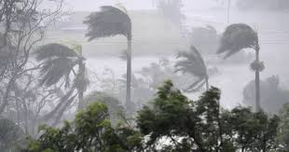
Why is geography important?
It affects how people live, work and play.
It affects what people eat, wear and own.
Where you live also affects the natural disasters you experience (earthquakes, bushfires, floods, hurricanes or cyclones).

Slide 6
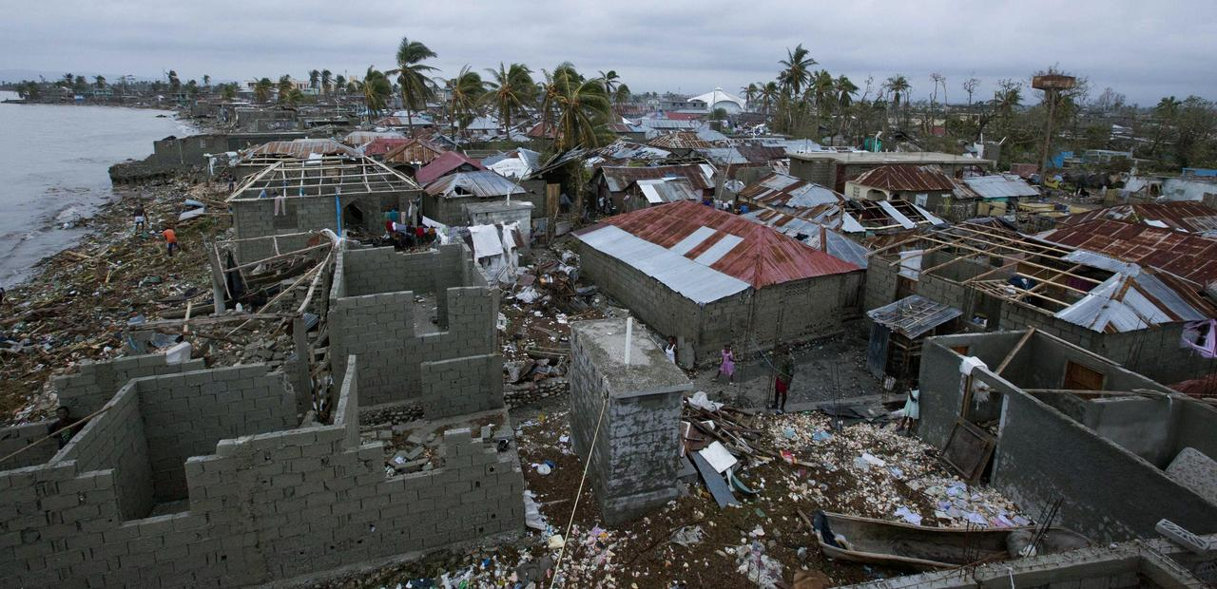
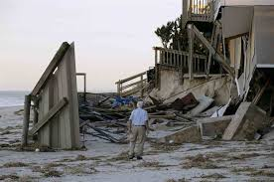
Learning about geography can help us understand events like Hurricane Matthew in 2016… events that impact humans on a drastic scale

Slide 7
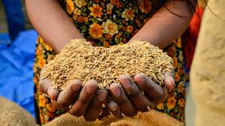
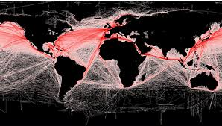
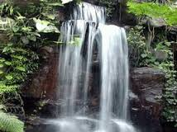
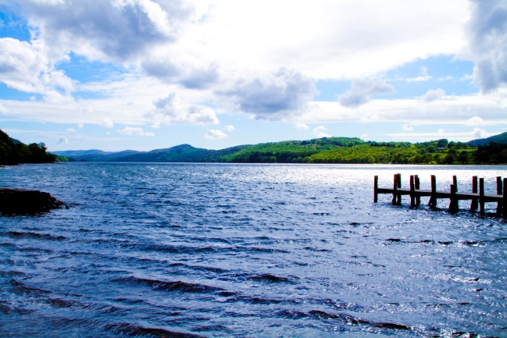
Geography this term
Water and the world: Why water is important to where humans live and how they live.
Liveability: what factors influence where people live.

Slide 8

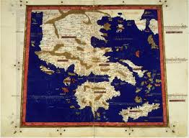
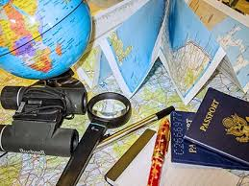
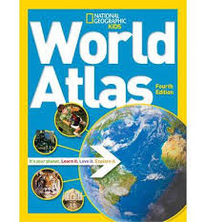
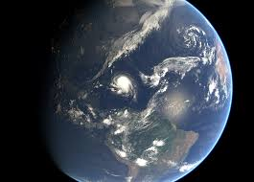
Geography Skills - Brainstorm
What methods or tools do geographers use to find information about our world?

Slide 9
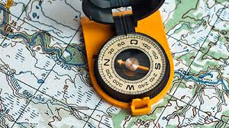
Geography skills and tools
Mapping
Graphs
Sketches
Photographs
Diagrams
Collecting and recording data
Fieldwork
Developing geographical questions

Slide 10
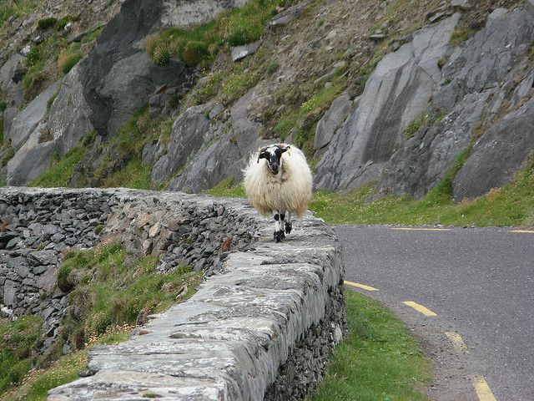
SHEEPT – a tool geographers use to analyse data
Social: Factors relating to culture and people.
Historical: Factors relating to the past.
Economic: Factors relating to earning or spending money.
Environmental: Factors relating to the natural environment (climate, landforms and vegetation).
Political: Factors relating to government.
Technological: Factors relating to the availability and the use of different types of technology.

Slide 11
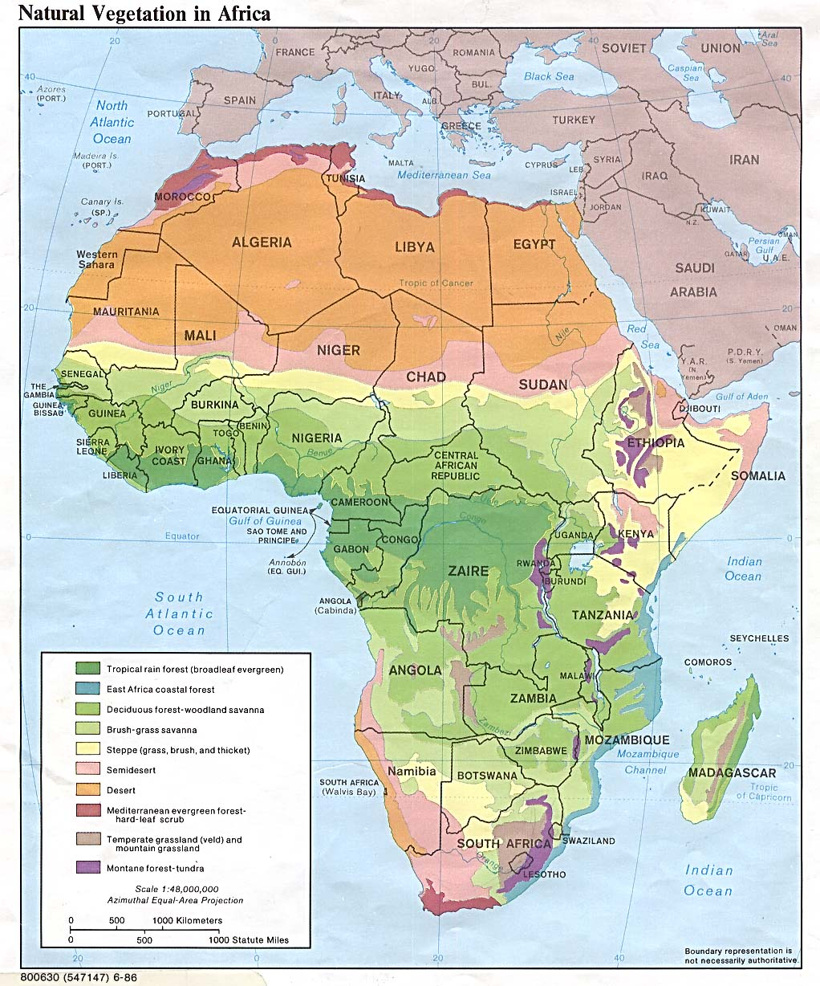
PQE - is a tool which is used in Geography to describe data in graphs, tables and maps.
Pattern : look for things that stand out in forms or patterns. For example the concentration of one colour on a map.
Quantity: involves using statistics, amounts, sizes and locations to give specific details. For example comparing the amount of forest in central Africa with that of east Africa.
Exceptions: things in data that don’t fit a pattern you have identified. For example forest is also found in parts of north and western Africa.

Slide 12
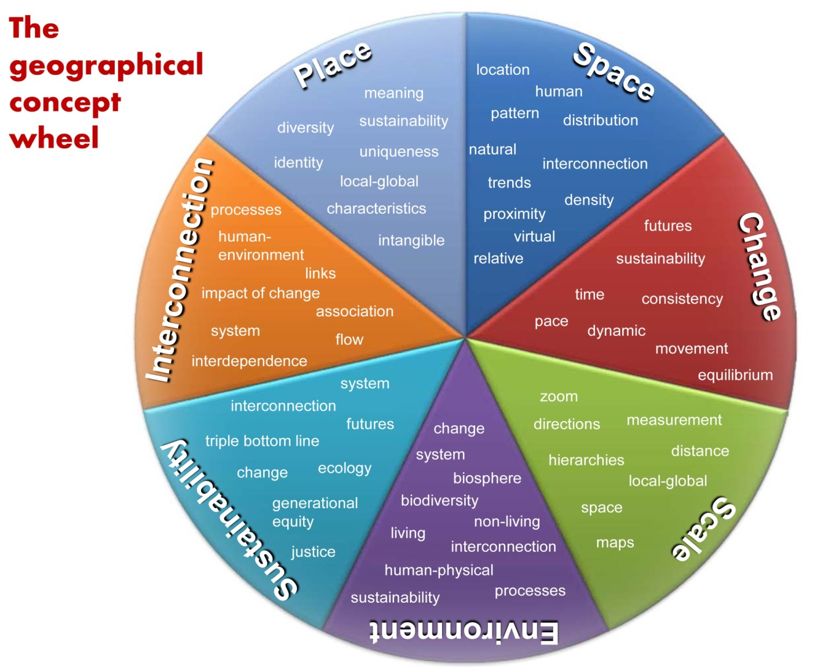
7 Key Concepts of Geography - SPICESS

Slide 13
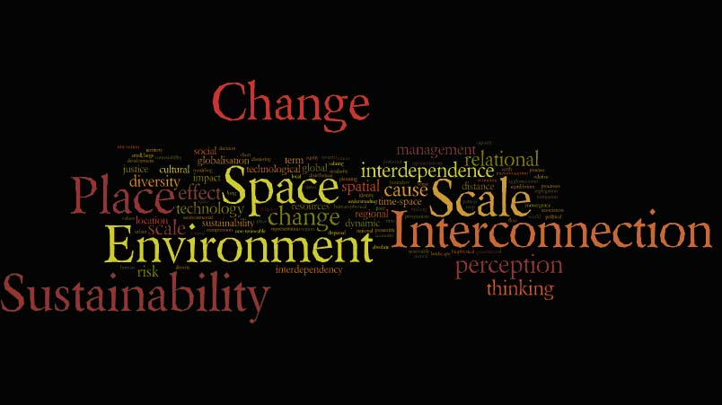
Remember SPICESS!
Space: A way of identifying how things are arranged on the Earth’s surface.
Place: A part of the Earth’s surface that is identified and given meaning by people.
Interconnections: How places are connected with other places, and how event in one location leads to change in another.

Slide 14

Remember SPICESS!
Change: Involves time and space. Naturally occurring or by humans will.
Environment: Physical and Biological World. Provides raw foods, materials and it recycles waste.
Sustainability: Maintaining full capacity of environment, and conservation of natural resources.
Scale: Personal and Local levels, regional, national and global levels. Local Events can have global outcomes.

Slide 15
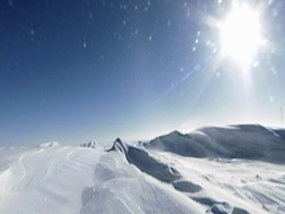
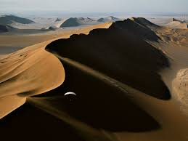
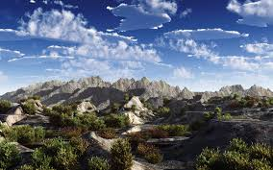
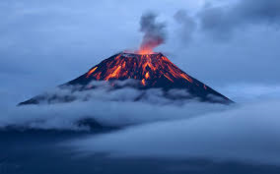
Recall the following concepts and then complete activities
SHEEPT
PQE
7 Key concepts

